Slide 1
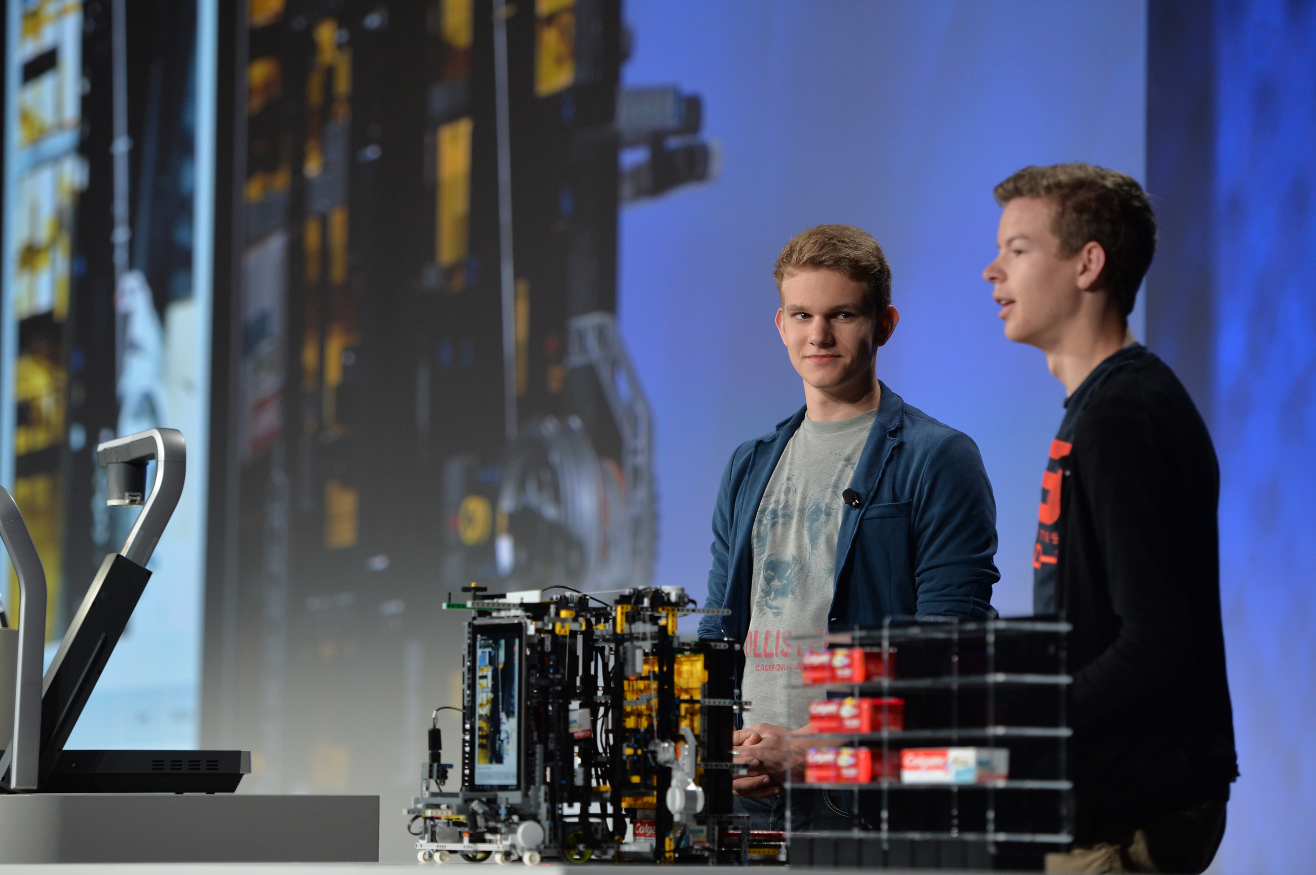
Creating Your Presentation
Choose your roles during the final presentation: who is going to deliver the pitch, who is going to do the demo of your solution
Divide your presentation in clear thoughts.
You will have 6 minutes for your whole presentation and it’s up to your team how you use this time. Keep in mind that the jury will expect to see also a demo of your solution during this time. After the presentation, the jury will have 4 minutes to ask questions.
Please use the template provided for your PowerPoint Presentation. The slides topics provided are mandatory. You can add other slides, but the jury will expect you to cover all the points mentioned in the provided template.
Don’t use too many slides, don’t add too much text, use the ppt file as a tool to help the jury understand your implementation.
Divide your presentation in clear thoughts.
Don’t spend too much time presenting the team, the task or other elements that the jury already know
Briefly State which tasks you managed to implement
Do not forget to mention the technologies you used to implement the solution. Explain what SAP tools you integrated in your solution and what for.
Present the architecture of your solution. You can draw the architecture on paper and insert the picture on the allocated slide. We want to have an overview understanding of your solution.
Briefly explain your implementation and emphasize the unique ideas. This can be done while you are doing the demo
Demo: Decide what’s important to show within the time you’re allocated. It’s important to show the audience what your project does and that you’ve completed the key components of it. We want to understand what tasks are functional.

Slide 2
Presentation Skills - BEGS
Body Language | Facial Expressions – SMILE! Posture Stand up straight with your feet slightly apart and arms ready to gesture Lean slightly toward the audience Don’t lean on the podium Don’t stand with your arms on your hips Don’t sway back and forth Don’t fold your arms across your chest Don’t stand in the fig leaf position Don’t bury your hands in your pockets
Eye Contact | Look at the individuals Establish eye contact at the end of a thought Look all around the room Don’t look out the window Don’t look at one spot Don’t let notes ruin your eye contact Don’t look over the heads of the audience
Gestures | Create opportunities to gesture Vary your gestures Make your gesture fit the space – small gesture for small room, large gestures for large room Don’t memorize gestures – they will look fake
Speaking Voice | Speak like you are talking to your best friend Don’t say “ah” or “um” , “okay”? Don’t be monotonous Use your voice for emphasis Don’t be afraid to pause
Note: The BEGS instructions are meant to help you deliver the presentation with confidence and explain the jury your solution. They are not mandatory, it’s up to you what you want to use.

Slide 3


Title Goes Here Team Name
Team Members’ Names
October 28th, 2018

Slide 4
Agenda
Technologies Used for Implementation
Implemented tasks
Solution Architecture
Functional DEMO – go briefly through all the implemented tasks

Slide 5
Technologies Used for Implementation
[No 1]
[No 2]
[No 3]
…

Slide 6
Implemented Tasks
Interface with the data API(mandatory) Implemented/Partially Implemented/Not Implemented
Visualization of warehouse content Implemented/Partially Implemented/Not Implemented
Simulation of warehouse operations Implemented/Partially Implemented/Not Implemented
Calculate required KPIs Implemented/Partially Implemented/Not Implemented
Analytics and visualization Implemented/Partially Implemented/Not Implemented
Forecast of deliveries Implemented/Partially Implemented/Not Implemented
Labelling Implemented/Partially Implemented/Not Implemented
Product availability optimization Implemented/Partially Implemented/Not Implemented
Deploy on SAP Cloud Platform Implemented/Partially Implemented/Not Implemented
Log performed action to remote API Implemented/Partially Implemented/Not Implemented
Notes:
Just mention which tasks you managed to implement, specifying if they are complete/partially implemented

Slide 7
Solution Architecture
Notes:
You can draw the architecture on paper and insert the picture here. We want to have an overview understanding of your solution.

Slide 8
DEMO
Notes:
Briefly show the implemented tasks

Slide 9
Thank you.
Team Name

